Slide 1
sNOW <-> JIRA integration Manoranjan Mohanty
Notes:
Security Classification
To determine the classification and handling requirements of information we must consider the consequences resulting from inappropriate or unauthorised handling such as fines, fraud or damage to our reputation. More information is available on the Security and Fraud Hub on Max.

Slide 2
Business case
Case 1: Integrate Incident to JIRA story.
Create an incident, new story will be created in JIRA automatically.
Close the story in JIRA, incident will be closed automatically.
Case 2: Integrate Agile module of ServiceNow with JIRA
Create a story in SNOW, new story will be created in JIRA.
Create a story in JIRA, new story will be created in SNOW.

Slide 3
Prerequisite
1. Basic knowledge on ServiceNow NOW platform and understanding of basic JavaScript.
2. Basic understanding of REST API.
3. A personal development Instance for ServiceNow (Optional)
4. A free atlassian account (Optional)

Slide 4
Useful Links
ServiceNow:
https://developer.servicenow.com/dev.do
Atlassian:
https://id.atlassian.com/login?continue=https%3A%2F%2Fstart.atlassian.com%2F
JIRA API:
https://developer.atlassian.com/cloud/jira/platform/rest/v3/api-group-issues/#api-rest-api-3-issue-post
JIRA API Example:
Jira REST API examples
JSON Viewer:
https://jsonviewer.com/
Online White-board:
https://awwapp.com/#

Slide 5
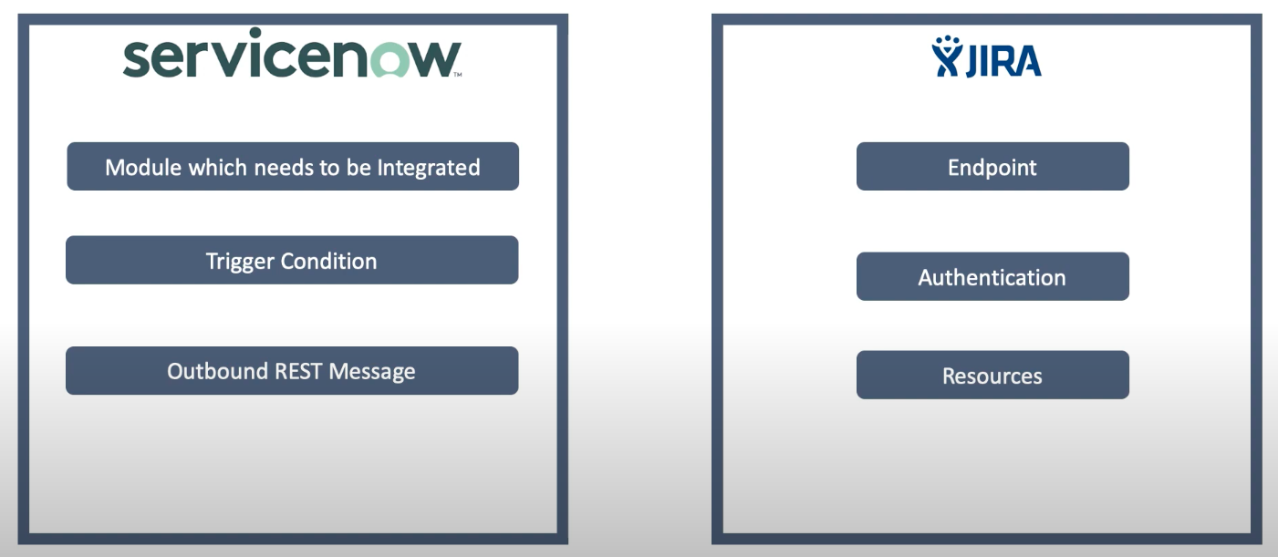

Slide 6
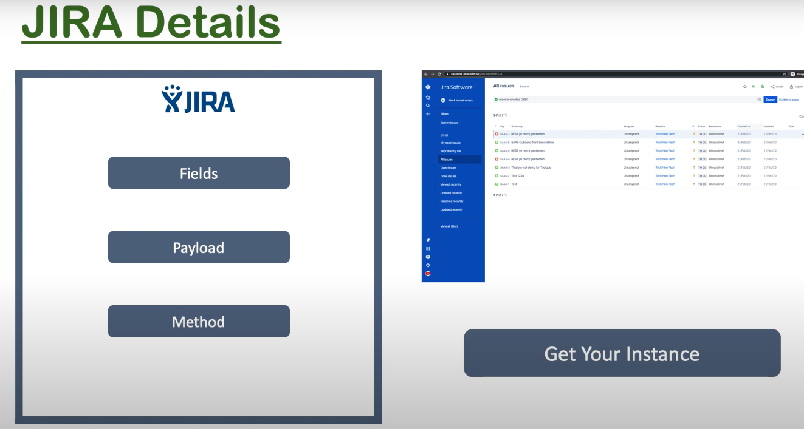

Slide 7
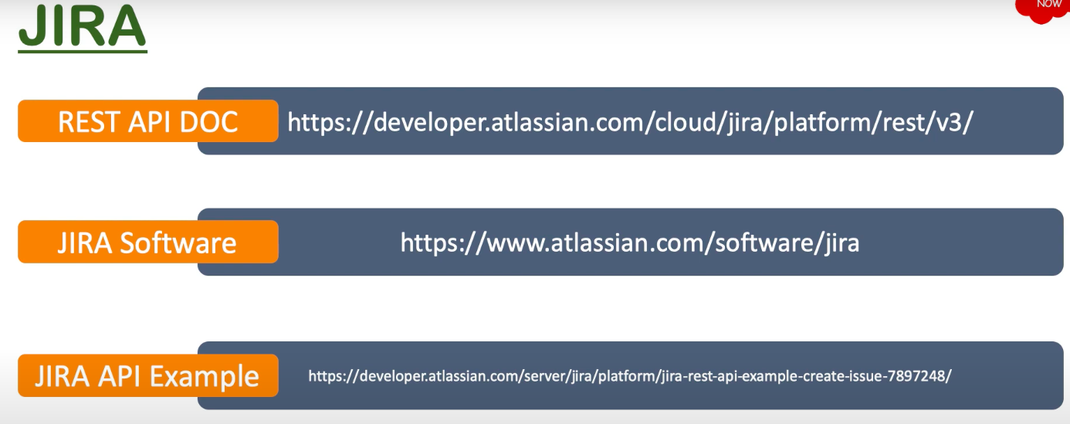

Slide 8
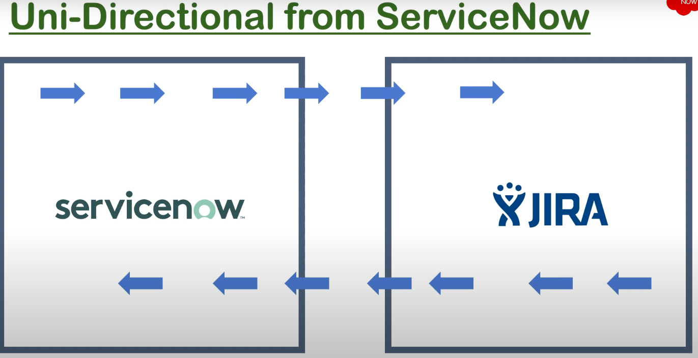

Slide 9
Case 1
Create
Atlassian account,
Project and API Key
Install Agile 2.0
Create REST Message and test GET
Create Schedule Job
Test POST API
Create async Business rule on sn_task table

Slide 10
Case 2
Add 2 custom field in JIRA.
SNOW SYSID
SNOW INCIDENTID
In SNOW, add
new ‘assignment Group’.
In incident form:
Sent to Jira
Jira_Issue_ID
business rule : PostToJira
Add Scheduled Job : job_br_jira_status
Test POST API
Add a REST Message.
Add Post Verb.

Slide 11
Thank you!

